Slide 1
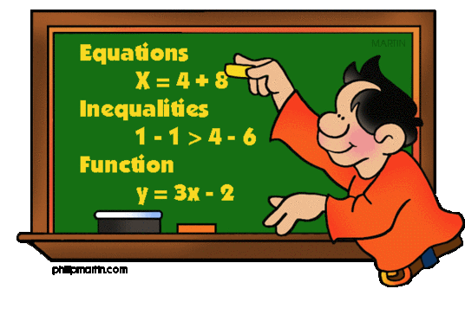
Inequalities
Chapter 6 Section 2

Slide 2
Objectives
Solve linear inequalities by using multiplication.
Solve linear inequalities by using division.

Slide 3
Noticing
8 > 5 Multiply each side by 2. | 5 > 3 Multiply each side by -2.
6 < 15 Divide each side by 3. | 6 < 15 Divide each side by -3.

Slide 4
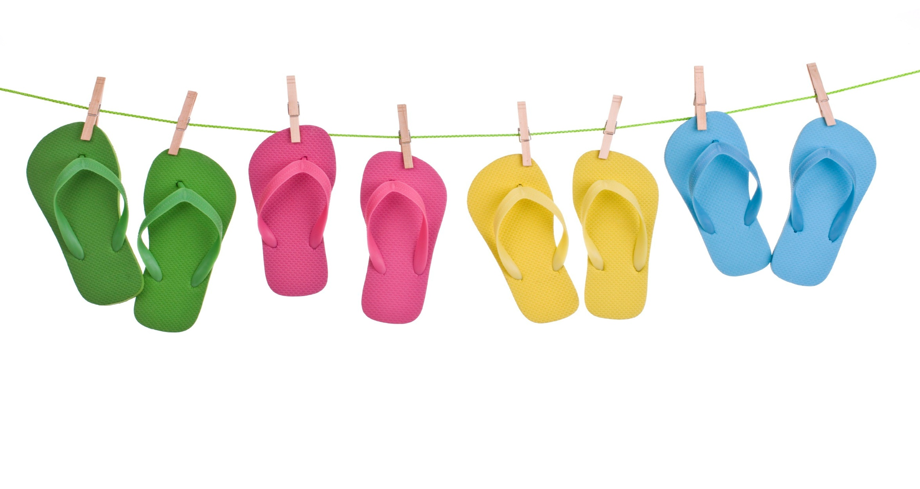
I want to remember ….
If each side of a true inequality is multiplied or divided by the same negative number, the direction of the inequality symbol must be reversed (flip-flop) so that the resulting inequality is also true.

Slide 5
Solve
25f ≥ 9 | $\frac{t}{9}$ < -12
-15g > 75 | - $\frac{2}{3}b ≤−9$

Slide 6
Solve
25f ≥ 9 | $\frac{t}{9}$ < -12
-15g > 75 | - $\frac{2}{3}b ≤−9$

Slide 7
Inequalities
< | > | ≤ | ≥
Less than Fewer than | Greater than More than | At most No more than Less than or equal to | At least No less than Greater than or equal to
Write and solve an inequality.
Half a number is at least 26.
1/2n ≥ 26
{n│n ≥ 52}

Slide 8
Inequalities
< | > | ≤ | ≥
Less than Fewer than | Greater than More than | At most No more than Less than or equal to | At least No less than Greater than or equal to
Write and solve an inequality.
The opposite of four times a number is more than 12.
-4n > 12
{n│n < -3}

Slide 9
Math Mind Growth
All evens on this page.

Slide 10
Math Mind Growth Continued
ONLY #27

