Slide 1
Exam Vocabulary

Slide 2
Product
The answer to a multiplication problem.

Slide 3
quotient
The answer to a division problem.

Slide 4
sum
The answer to a addition problem.

Slide 5
difference
The answer to a subtraction problem.

Slide 6
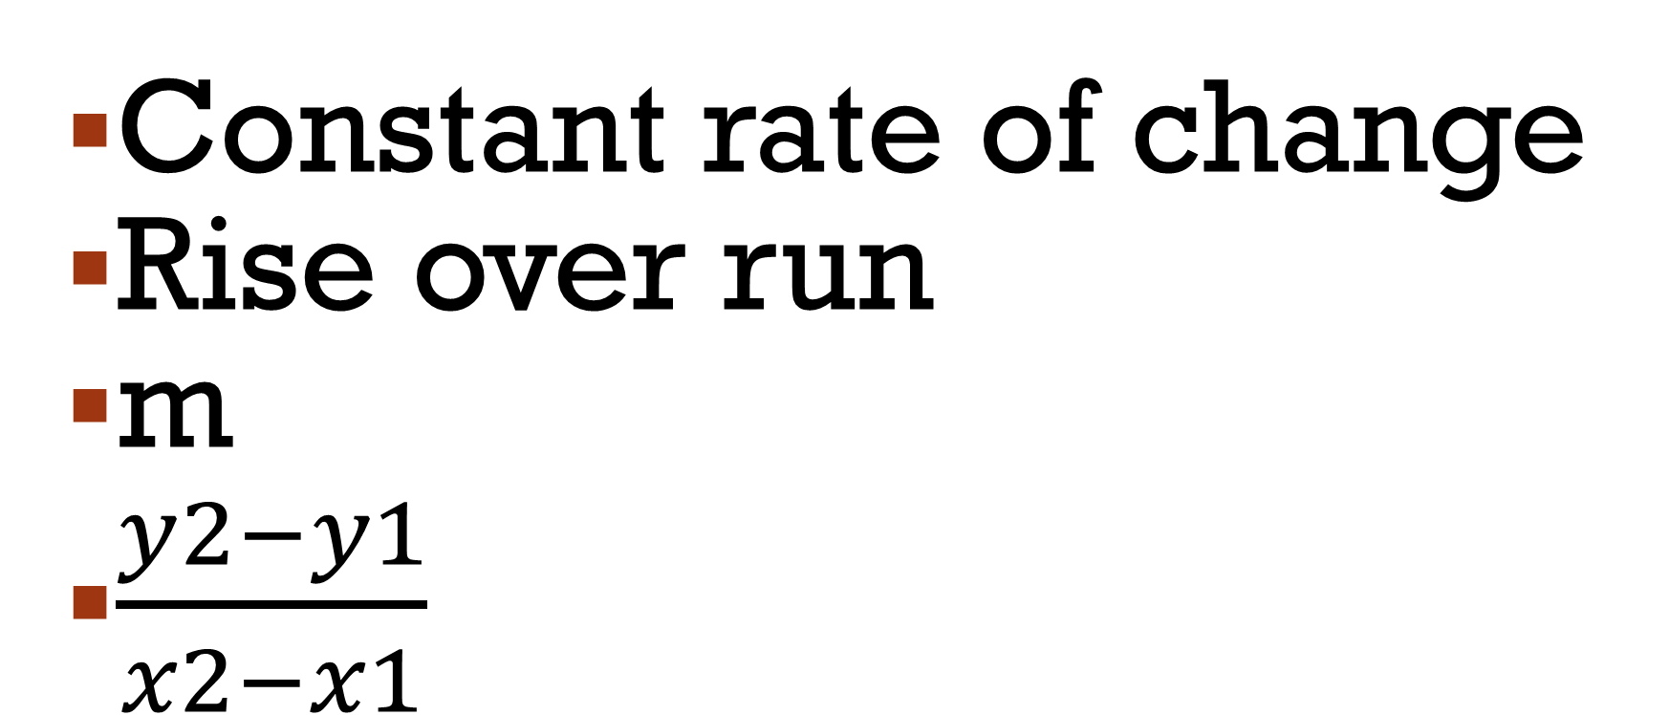
slope
Constant rate of change
Rise over run
m
$\frac{y2−y1}{x2−x1}$

Slide 7
Slope continued
Positive slope
Negative slope
Zero slope (horizontal line)
Undefined slope (vertical line)

Slide 8
Y-intercept
Represented by the letter b
Where the graph crosses the y-axis

Slide 9
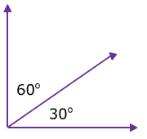
Complementary angles
Add up to 90 degrees.

Slide 10
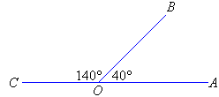
Supplementary angles
Add up to 180 degrees.

Slide 11
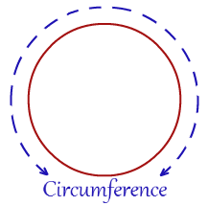
circumference
Distance around a circle.

Slide 12
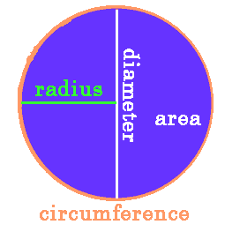
radius
The distance from the center of a circle outwards.

Slide 13
diameter
The distance across a circle

Slide 14
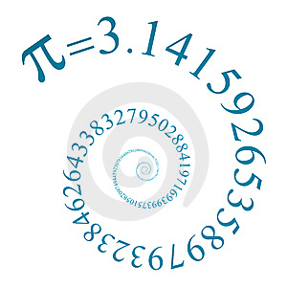
pi
Irrational
Doesn’t repeat
Doesn’t terminate

Slide 15
perimeter
Outside of a shape. Found by adding all side lengths.
Labeled feet, inches, etc.)

Slide 16
area
Inside of a shape. Found by multiplying bh.
Labeled squared.

Slide 17
Volume
The space a 3D shape occupies. Found by multiplying lwh.
Labeled cubed.

Slide 18
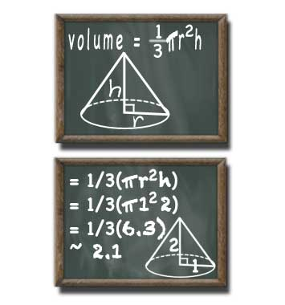
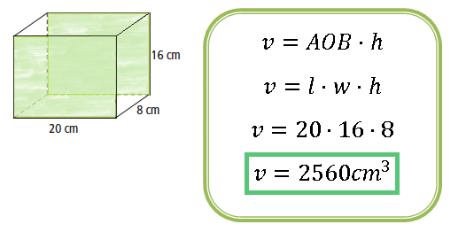
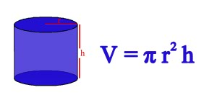
Volume continued

Slide 19
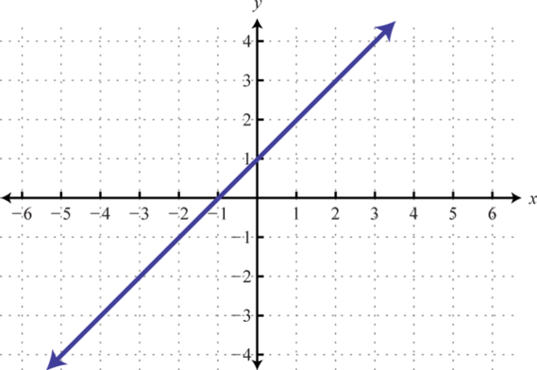
linear
Straight line

Slide 20
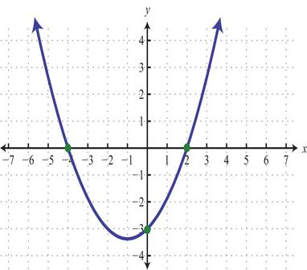
Non-linear
Not a straight line.

Slide 21
function
Passes the vertical line test.
Domain (x-values)doesn’t repeat.
Range (y-values) can repeat.

Slide 22
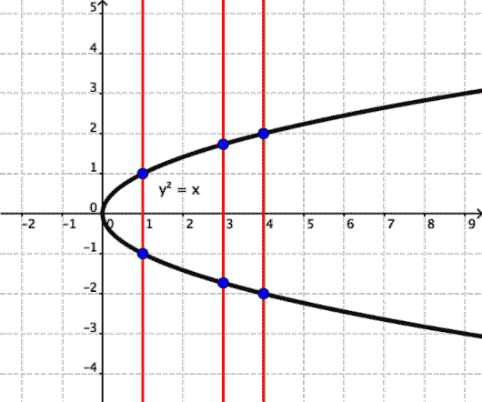
Vertical line test
Not a function, doesn’t pass vertical line test.

Slide 23
One solution
x = 7

Slide 24
No solution
6 ≠ 7

Slide 25
infinite solutions
7 = 7

Slide 26
Measures of central tendency
Mean (average)
Median (middle)
Mode (occurs most often)
Range (difference between largest and smallest numbers)

Slide 27
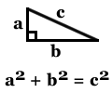
Pythagorean theorem
Right triangles only

